Slide 1



Analyzing Archival FIMS/SPEAR Data to Construct a Far-Ultraviolet (FUV) Background Map
Colton Quirk
Mentor: Dr. Haeun Chung, University of Arizona, Department of Astronomy/Steward Observatory
Arizona Space Grant Symposium, University of Arizona, April 5, 2024

Slide 2
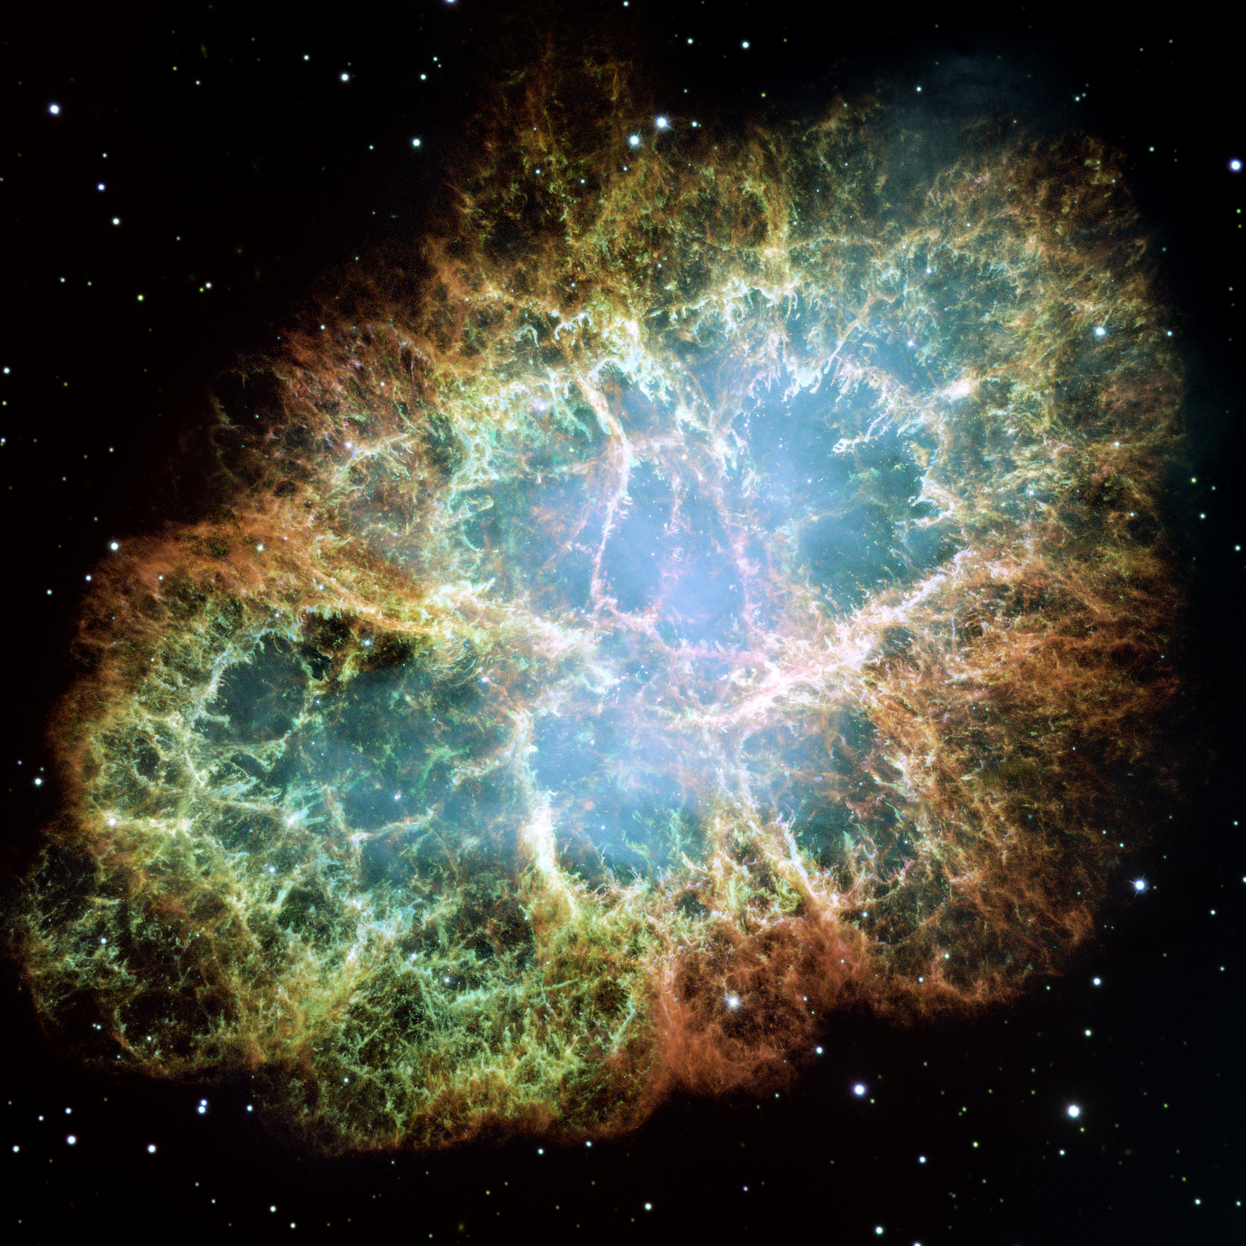
Introduction
Importance of UV background radiation
Warm and Hot plasma cooling
Molecular hydrogen fluorescent
Dust-scattered starlight
UV background radiation levels exceed those predicted by known UV-emitting processes
Image Credit: NASA, ESA and Allison Loll/Jeff Hester
Notes:
Greeting and Brief Overview: Start with a greeting and introduce the observation that UV background radiation levels exceed those predicted by known UV-emitting processes, highlighting the significance of solving this puzzle in astrophysics.
Background Context: Briefly explain the importance of understanding UV background radiation in the study of the universe and mention common sources of UV radiation and previous attempts to measure it.

Slide 3
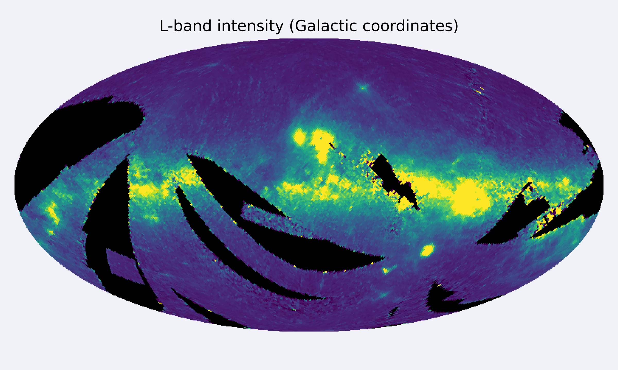
Research Question and Objectives
Why observed UV background radiation levels surpass predictions?
Construct an accurate FUV background map using FIMS/SPEAR data
Investigate the potential link to Lyman-Beta emission line scattering
Image Credit: Mikulski Archive for Space Telescopes
Notes:
Statement of the Research Question: Pose the question of why observed UV background radiation levels surpass predictions and what processes could account for this excess.
Objectives: Introduce the objective to construct an accurate FUV background map using FIMS/SPEAR data and investigate the potential link to Lyman-beta emission line scattering.

Slide 4
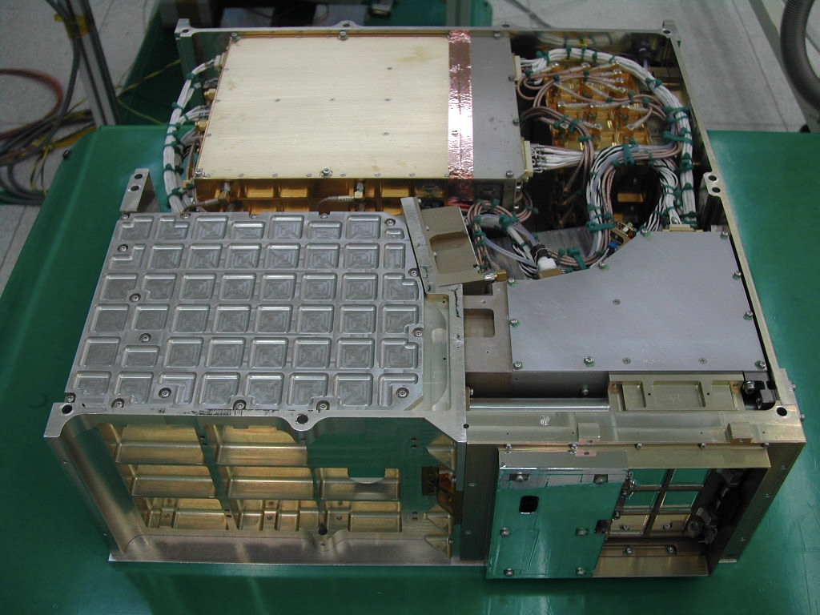
FIMS-SPEAR and Lyman-Beta Emission Line
First large-area spectral imaging survey of FUV
Korea: "Far-Ultraviolet Imaging Spectrograph" (FIMS)
US: "Spectroscopy of Plasma Evolution from Astrophysical Radiation" (SPEAR)
Issues with S-Band
Airglow Emission Lines
Instrument Background Noise
Lyman-Beta Emission Line
Image Credit: Mikulski Archive for Space Telescopes

Slide 5
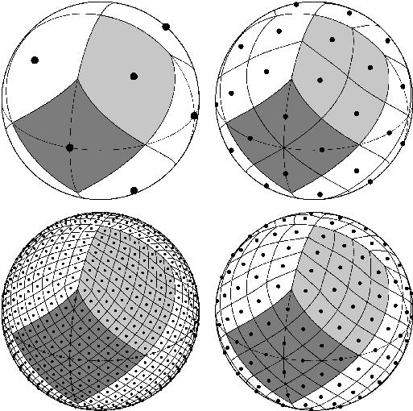
Methodology
Construct FUV Map
HEALPix Data Structure
Data analysis pipeline
Reduce the data
Identify correlation between pixel intensity and Lyman-Beta line
Corrects excess light
Image Credit: HEALPix Documentation
Notes:
Research Design: Describe your approach to using FIMS/SPEAR data for constructing the FUV background map.
Data Collection and Analysis: Explain the development of a data analysis pipeline that corrects excess light by identifying correlations between pixel intensity and the Lyman-beta line, allowing for more accurate adjustments of the FUV background.

Slide 6
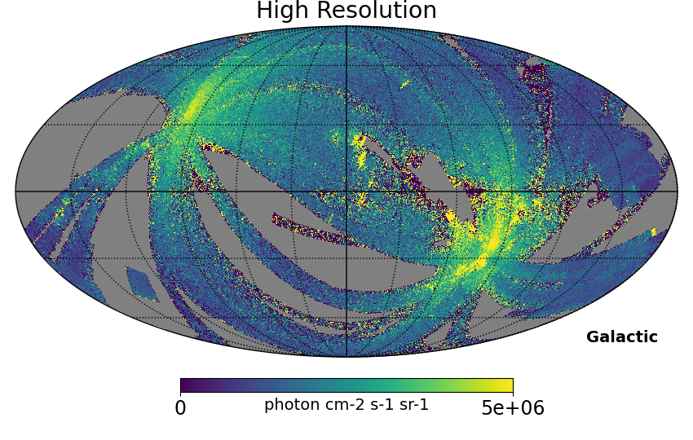
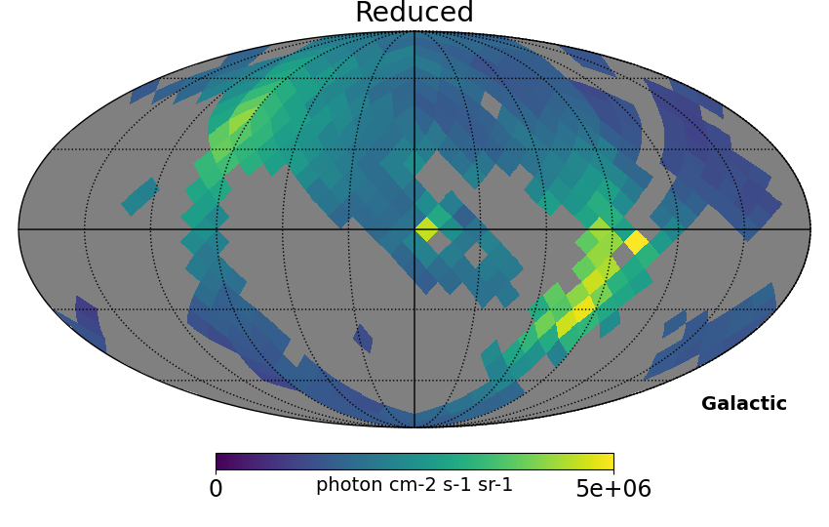
Reduce the data
Convert Data from NSIDE 128 to 008
196608 Pixels to 768 Pixels

Slide 7
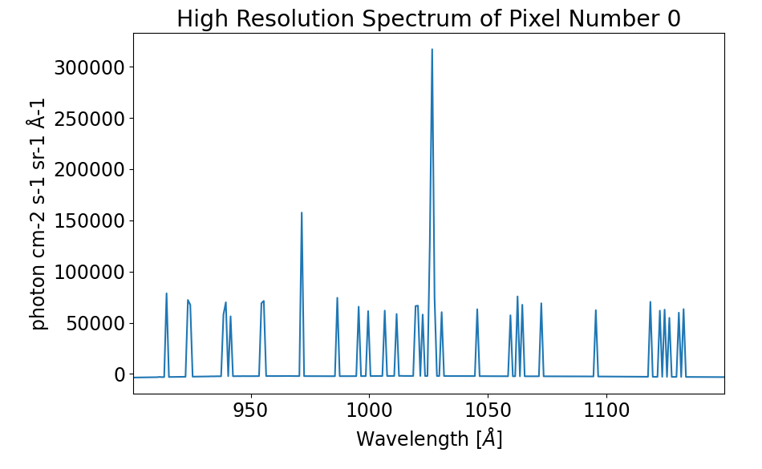
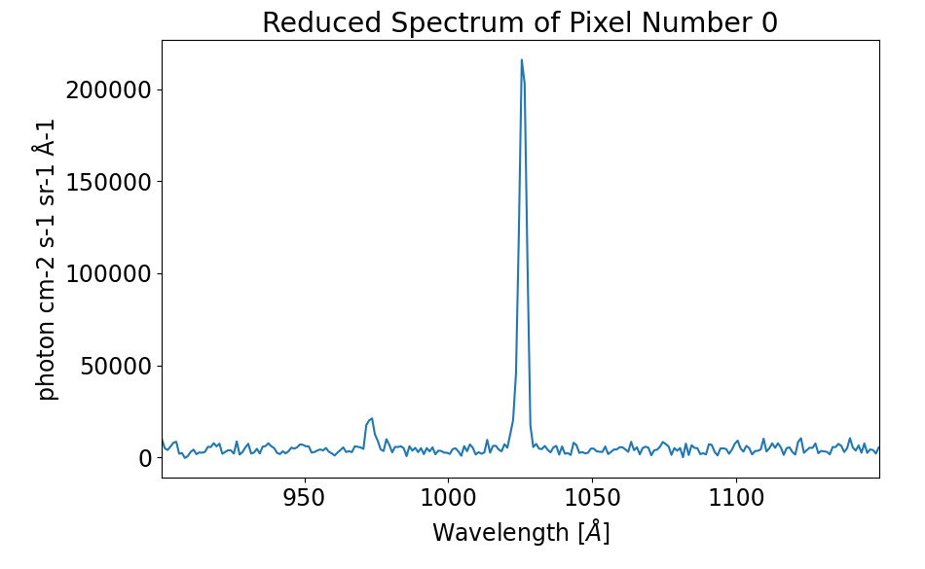
Reduce the data
Lyman-Beta Emission
Lyman-Beta Emission
Reduces Noise in the Spectrum
Continuum Signal Increases
Lyman-Beta Emission Line: 1026 Å

Slide 8
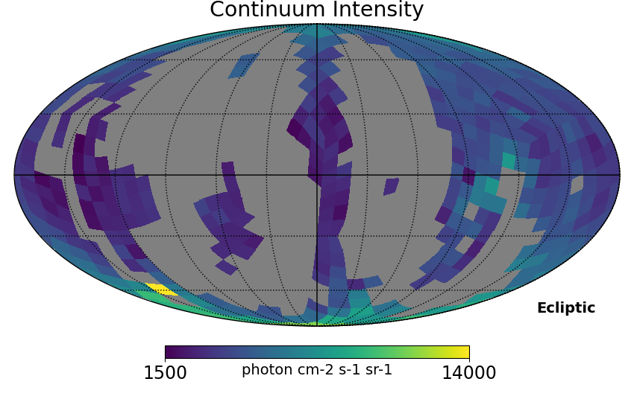
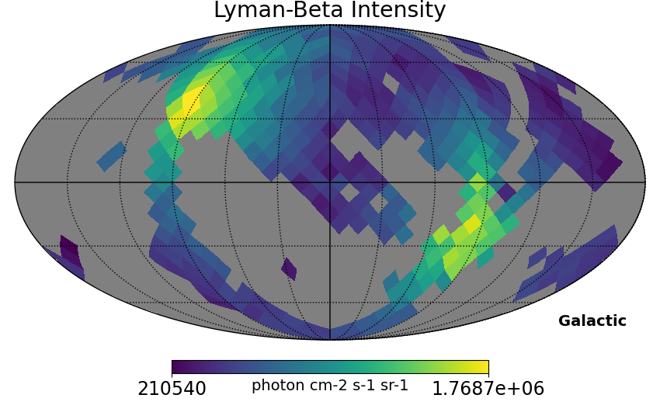
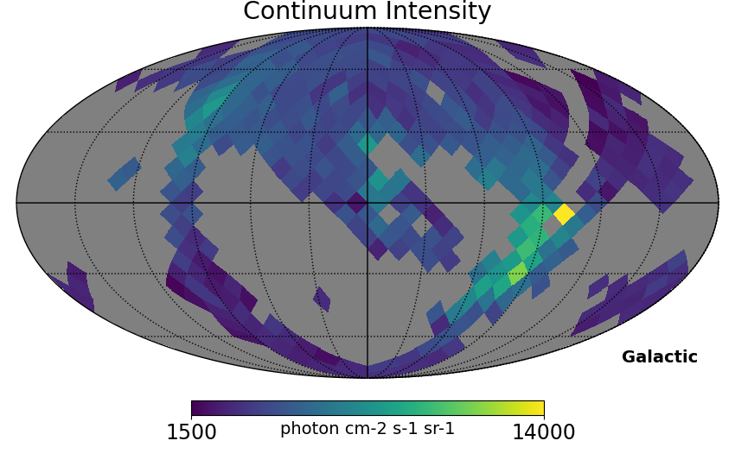
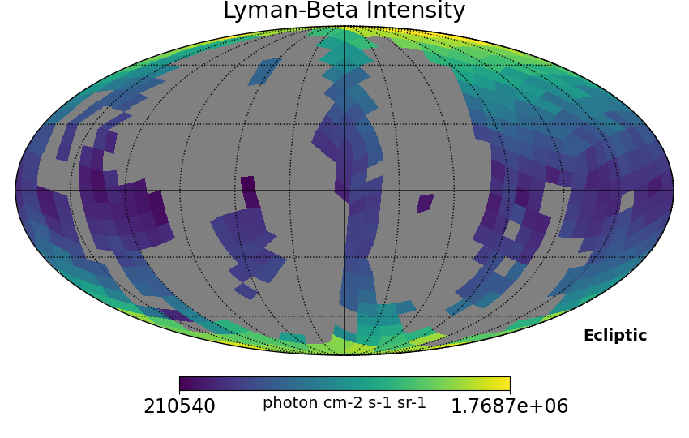
Measure Background and Lyman-Beta
Find the Continuum Level and Lyman-Beta level for each pixel

Slide 9
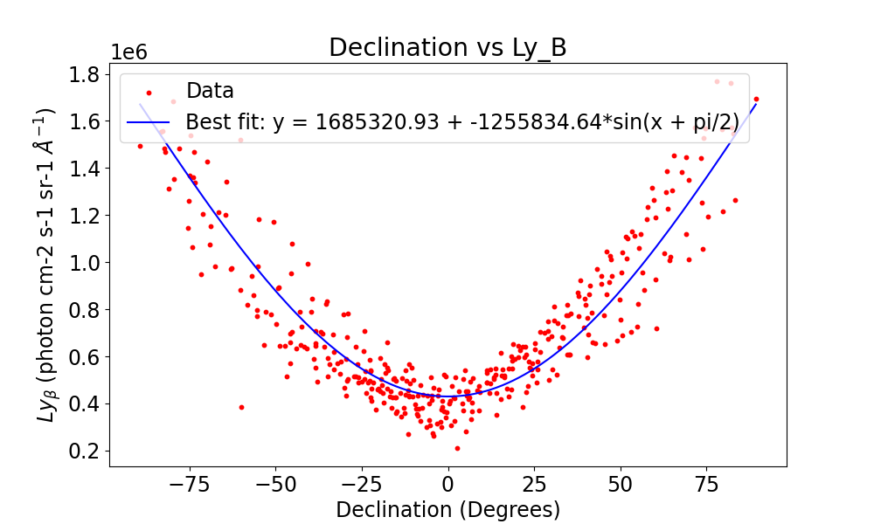
Link Between Lyman-Beta and Declination
Correlation between Lyman-Beta Intensity and Declination
Auroral activity is stronger near the poles

Slide 10
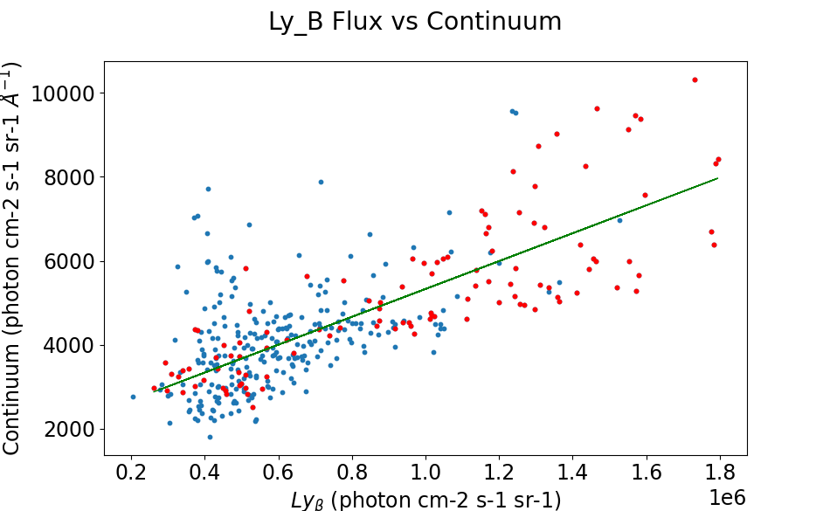
Link Between Continuum and Lyman-Beta
Correlation between Lyman-Beta Intensity and Continuum
Subtracted Lyman-Beta Contribution from the Continuum

Slide 11
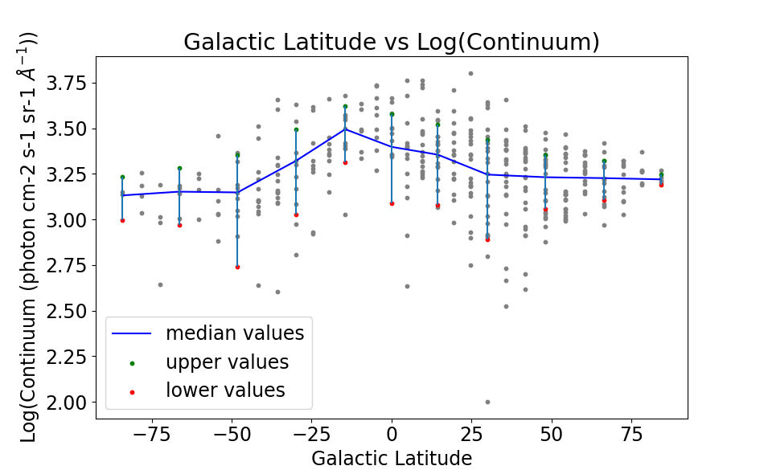
Galactic Latitude vs Continuum
Relation between Galactic Latitude and Continuum

Slide 12
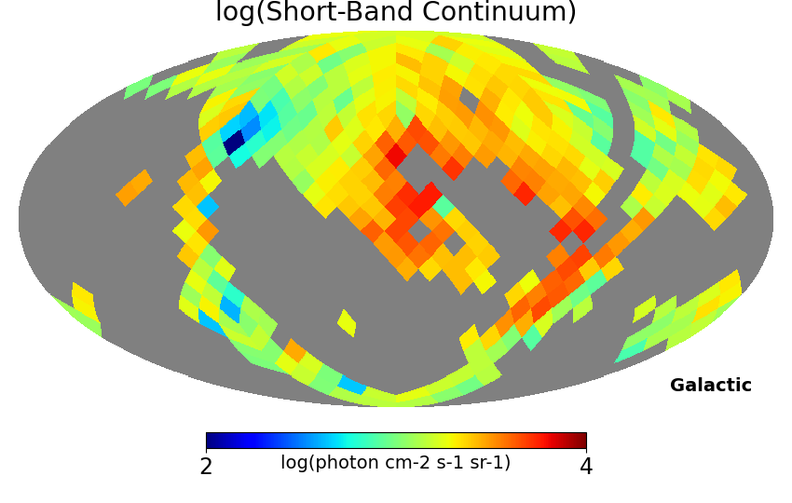
Key Findings
Higher UV radiation levels potentially linked to Lyman-Beta emission line scattering
Refinement of UV background radiation measurement
Notes:
Major Results: Highlight the discovery of higher UV radiation levels potentially linked to Lyman-beta emission line scattering and how your analysis corrected this excess light.
Implications: Discuss the implications of these findings, emphasizing the refinement of UV background radiation measurement and the importance of accounting for scattering effects in future space-based observations.

Slide 13
Future Directions
Consider other Airglow Emission Lines
Importance of accounting for scattering effects in future space-based observations
Future missions aimed at measuring UV background radiation with greater sensitivity
Notes:
Recap and Impact: Summarize how your findings refine the measurement of UV background radiation and underscore the necessity of considering scattering effects.
Future Research: Advocate for future missions aimed at measuring UV background radiation with greater sensitivity than FIMS/SPEAR, pointing to the continued importance of this research for astrophysics.

Slide 14
Acknowledgements
Dr. Haeun Chung, University of Arizona, Department of Astronomy/Steward Observatory
Michelle Coe and Dr. Chandra Holifield Collins, Arizona Space Grant Consortium
Arizona Space Grant Consortium
NASA
University of Arizona
Steward Observatory

Slide 15
Thank You

